Slide 1


MOCKMASTER
STATUS
by-
Kratika Nigam
Manmohan Dwivedi

Slide 2




1- Synopsis
MILESTONES
2- Entity relationship
3- DataFlow
4- Front-End
5- Back-End

Slide 3
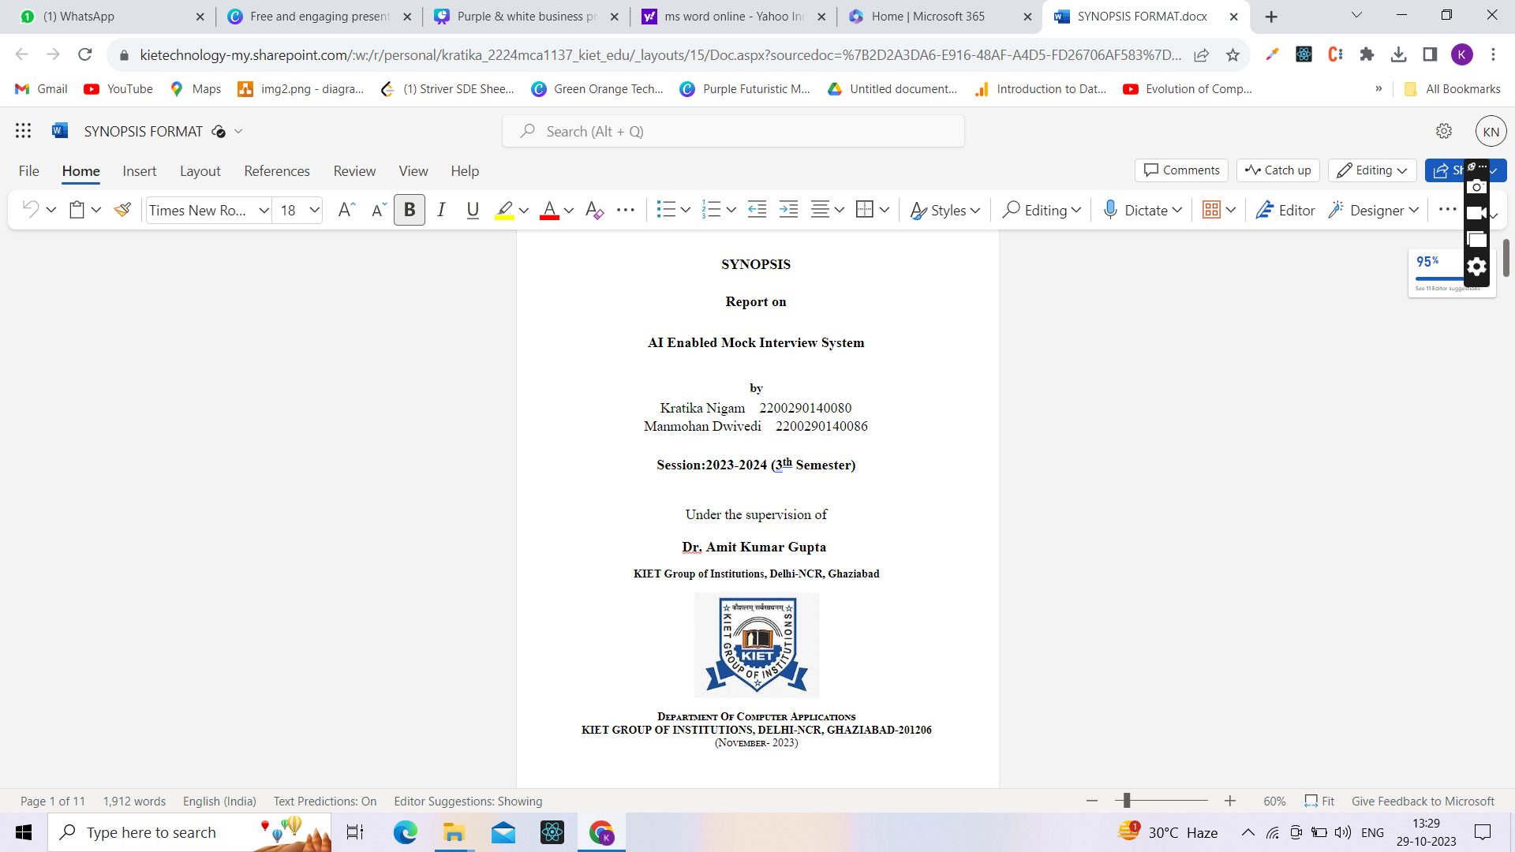

1
SYNOPSIS

Slide 4

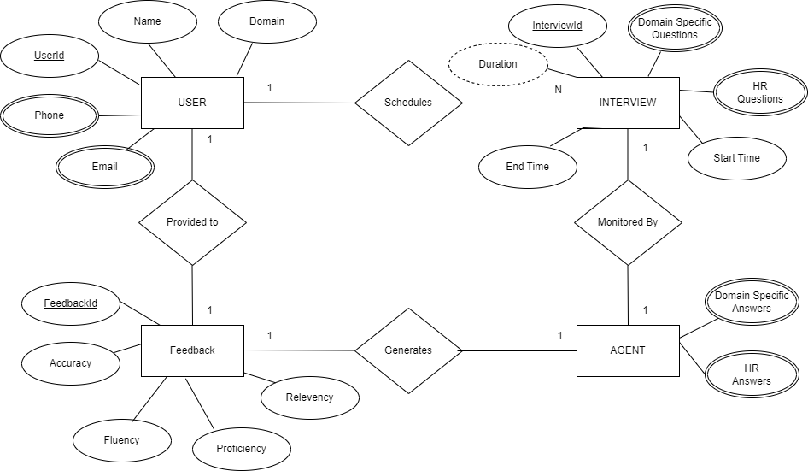

ENTITY RELATIONSHIP

Slide 5

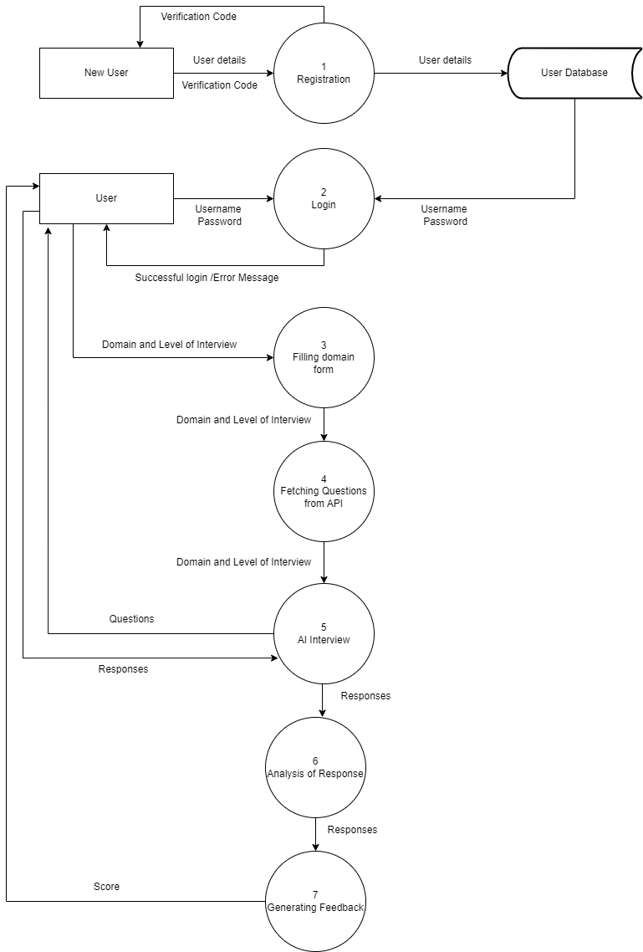
3
DATA FLOW
Additional Databases
Agent
Questions
Feedbacks

Slide 6
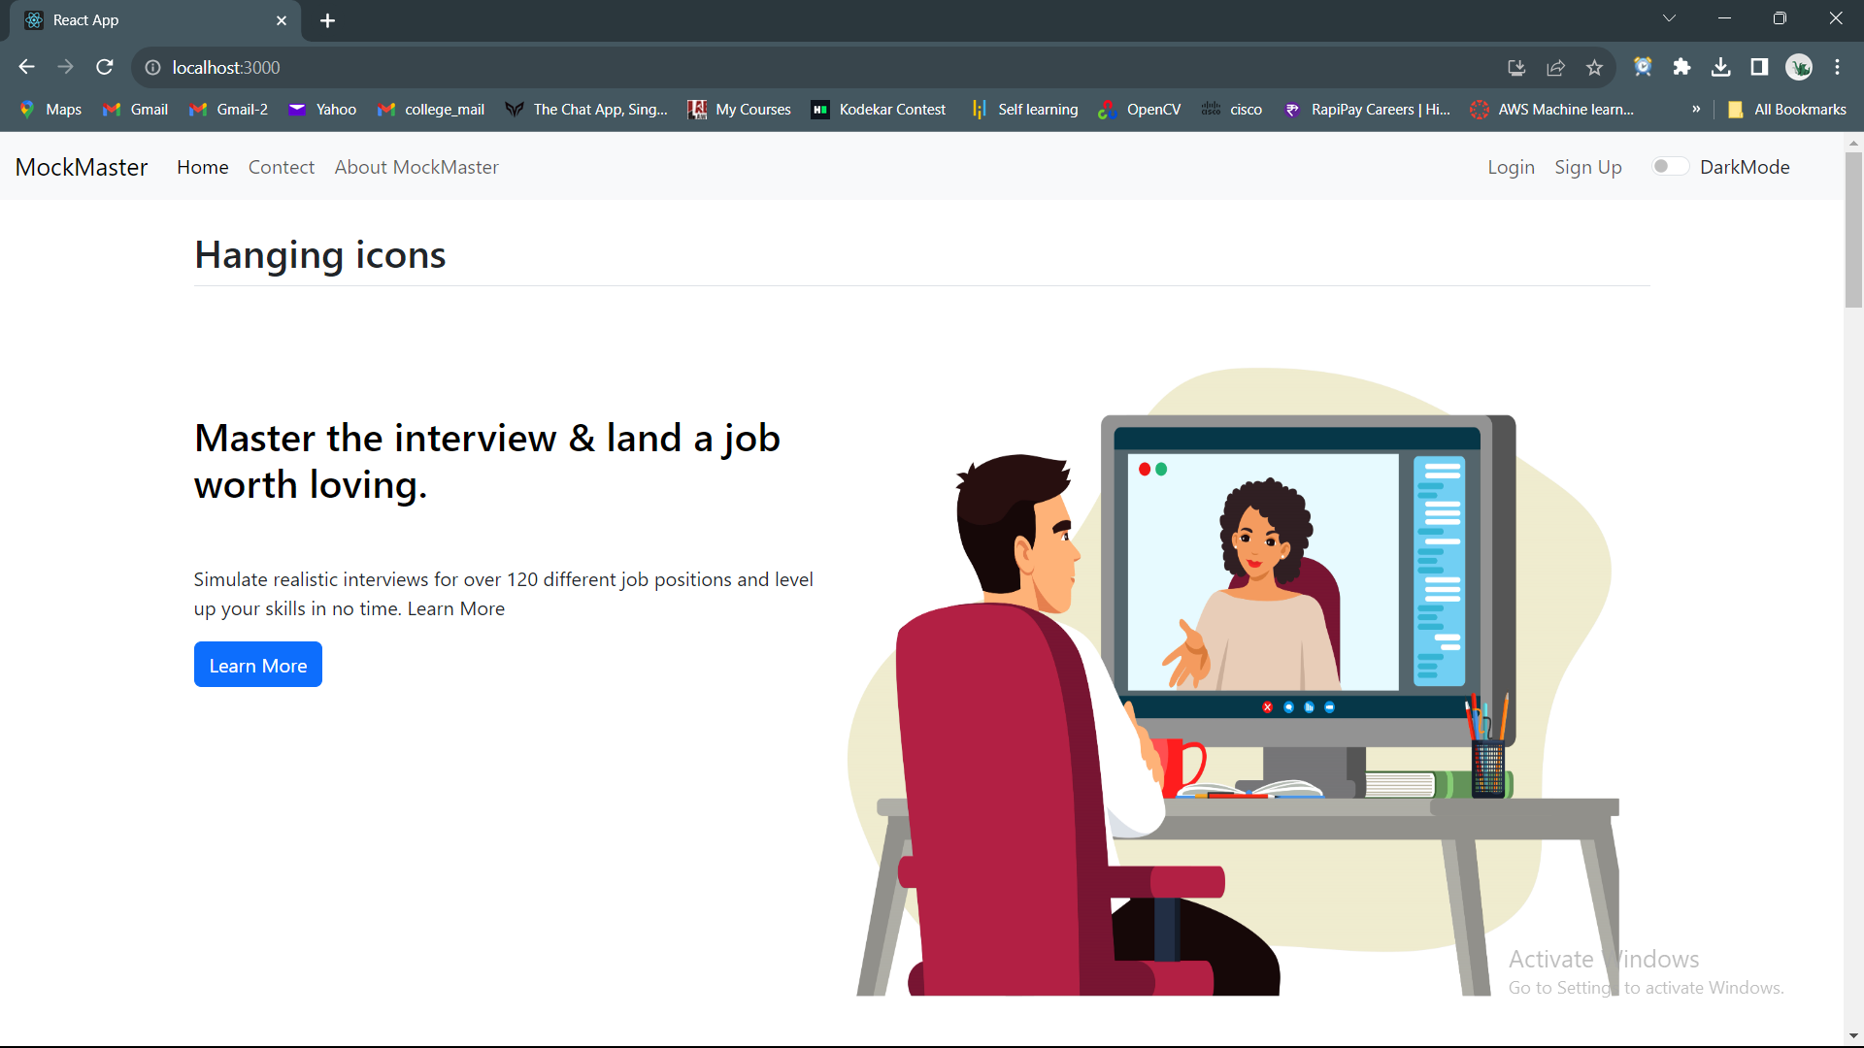
FRONT- END

Slide 7
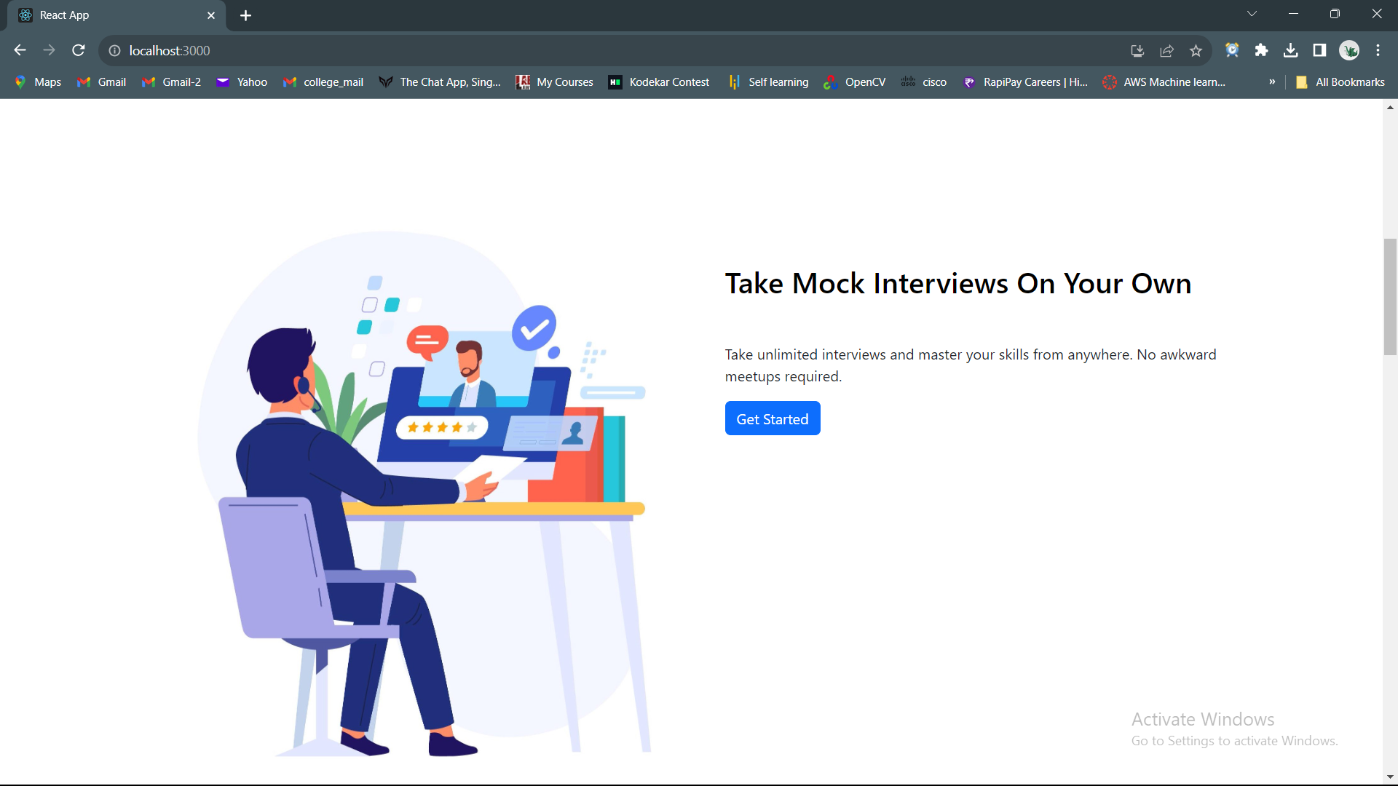
FRONT- END

Slide 8
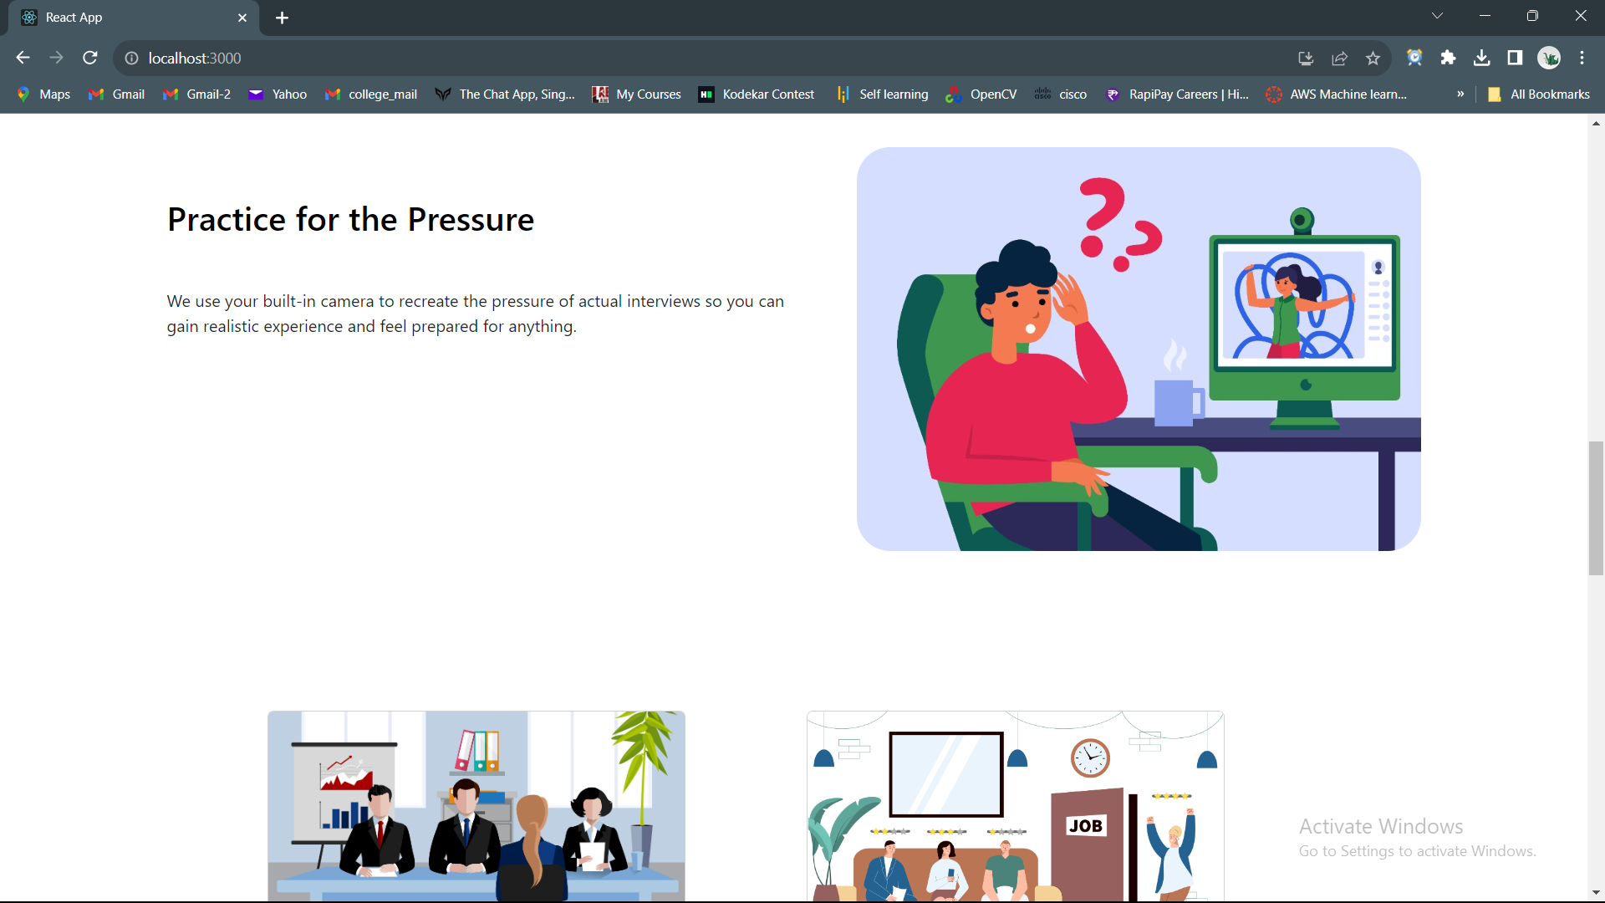
FRONT- END

Slide 9
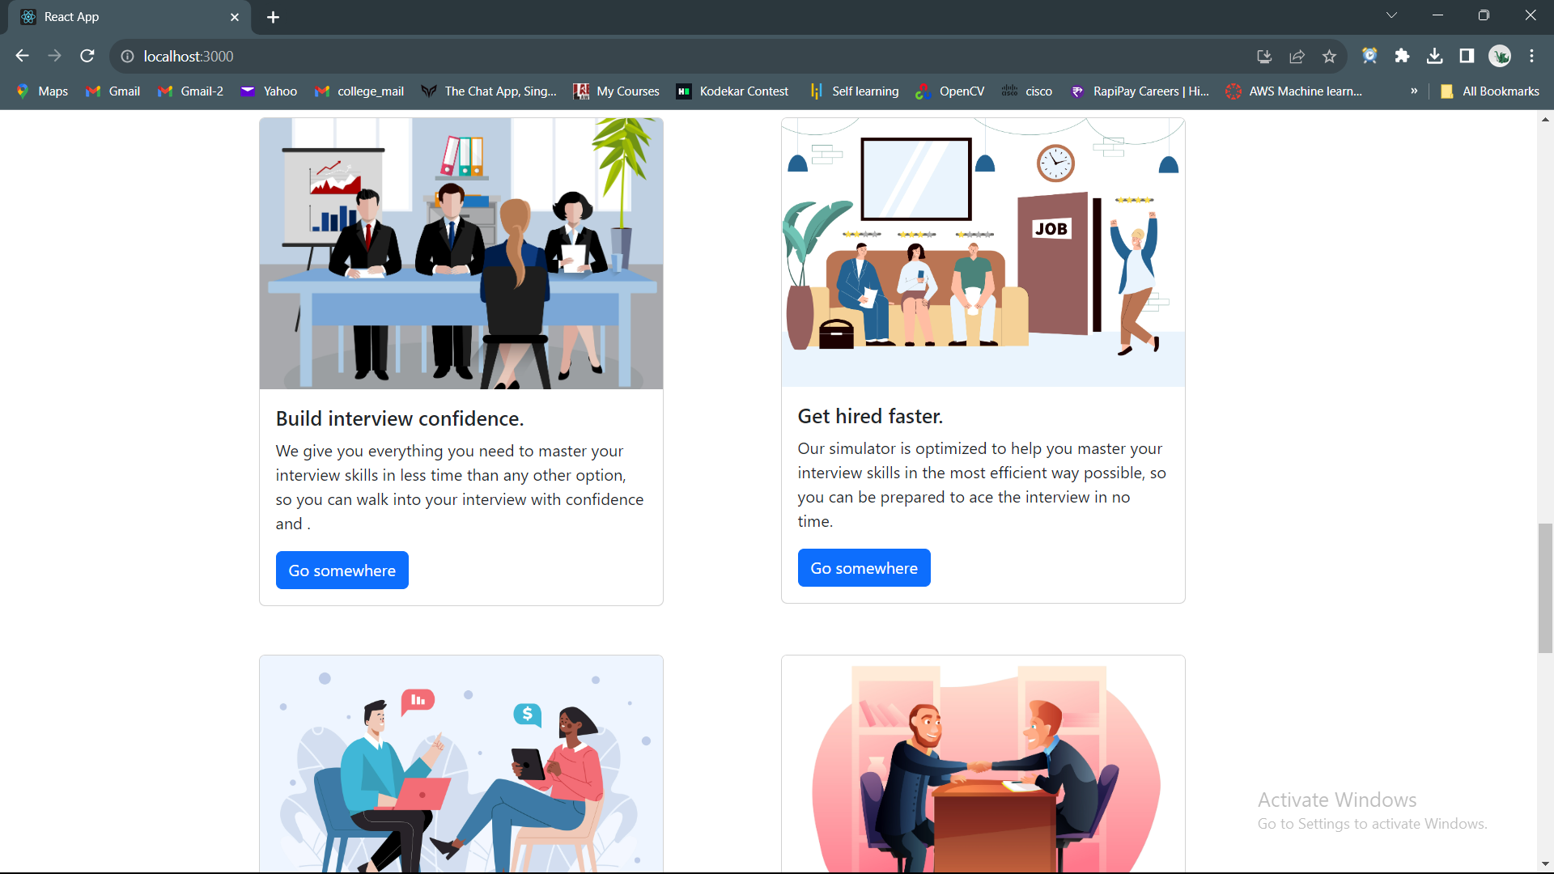
FRONT- END

Slide 10
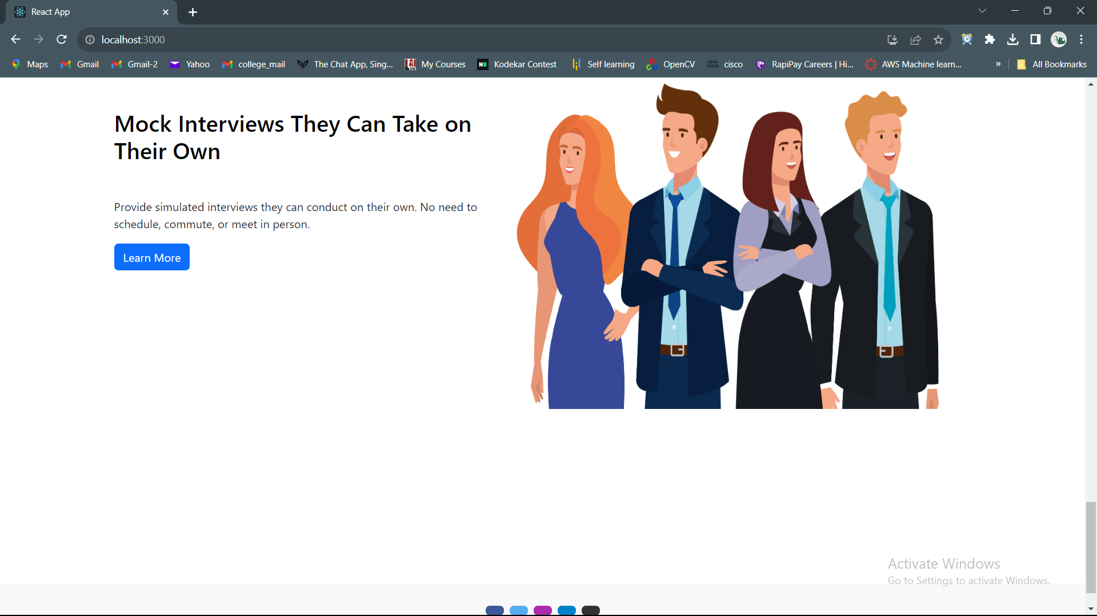
FRONT- END

Slide 11
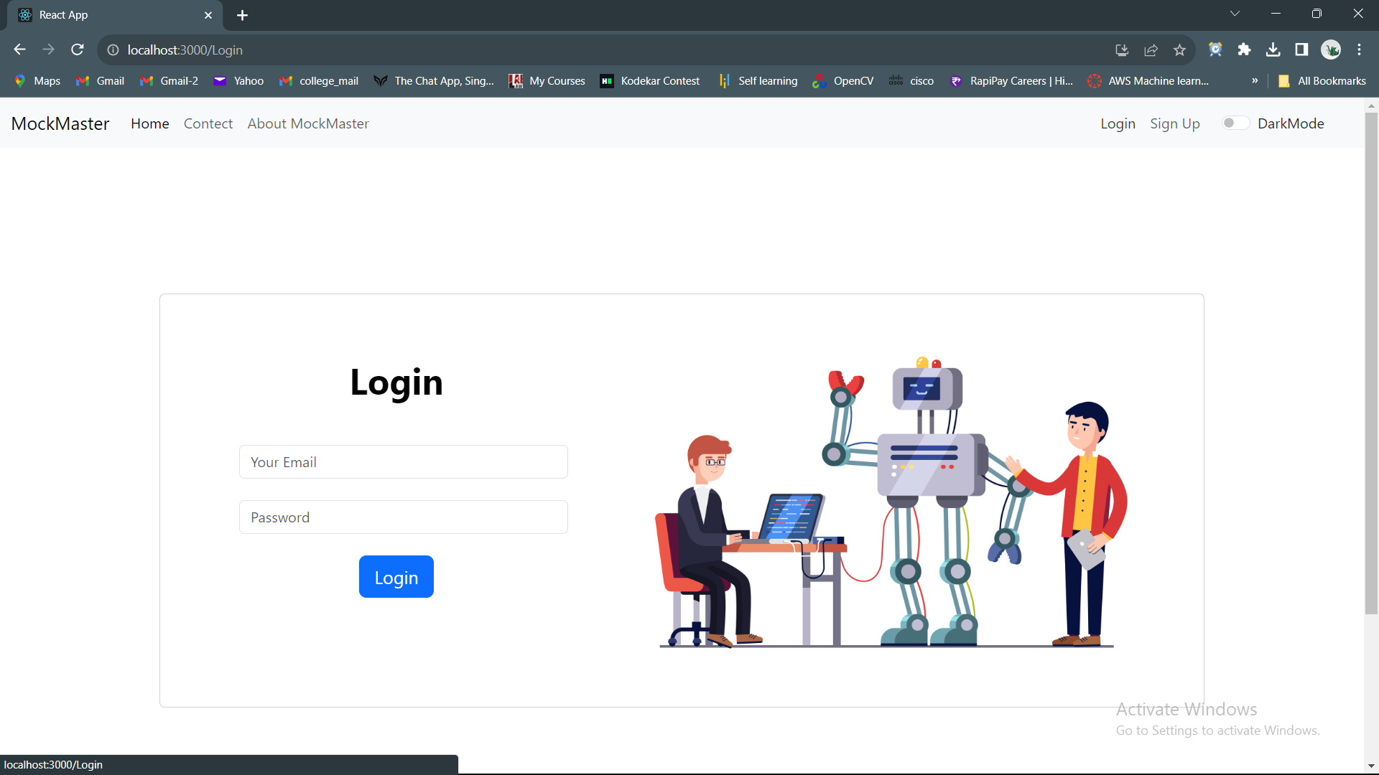
FRONT- END

Slide 12

THANK YOU

